Slide 1
Optical Tweezers
Kevin Evans
December 7, 2020
Notes:
My presentation is on optical tweezers

Slide 2
What we’ll go over…
We’ll go over a brief history of optical tweezers
Provide a simplified approximation using geometric optics
Discuss applications of optical tweezers
Notes:
In the presentation, we’ll be going over background information on this tool, as well as a short history of optical tweezers
Next, I’ll provide a simplified approximation of the forces using geometric optics, and include a bit on an electric dipole approximation
I’ll also provide several applications of optical tweezers

Slide 3
Introduction
Basically a tractor beam for miniscule objects
Often used molecular biology and medicine
Uses a Gaussian source and the momentum of light
Developed by Arthur Ashkin at Bell Labs about fifty years ago
Notes:
Optical tweezers are basically the tractor beams you’d see in scifi shows and film, but only for tiny objects, on the order of a micron.
Typically, on the order of micron-sized dielectric spheres, but can work on other objects. You can attach objects to the spheres if youd like to work, like biomolecules and such.
Uses a Gaussian source of light and the gradient of that light across a dielectric sphere to manipulate it. As the light diffracts across the sphere, the light’s rays are bent, carrying with it the momentum of the light and forces the sphere toward the gradient center. I’ll cover this in greater detail shortly.
Arthur Ashkin at Bell Labs began the development of this in the late 60s and refined it shortly to a usable optical trap. As you prob know, it won the nobel prize in 2018.

Slide 4



Background Momentum of light
Photons carry momentum, $p=ℏk$
Can describe radiation pressure, proportional to the intensity
For a constant area, the force is proportional to the intensity too,
$$P=\frac{\left\langle S\right\rangle }{c}=\frac{I}{c}$$
$$F∝\frac{I}{c}$$
Notes:
As most of you know, photons carry momentum, hbar k
This momentum leads to radiation pressure, proportional to the intensity over c
At a constant area, the force due to light emission is proportional to the intensity of light

Slide 5
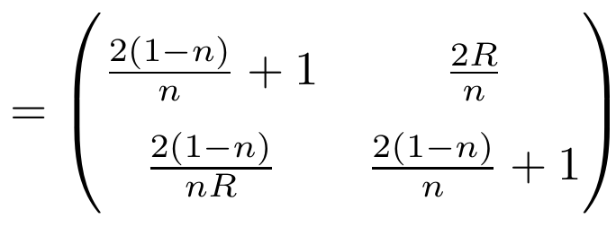
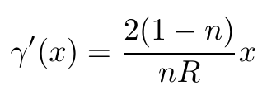

Systems matrix of a sphere
A glass/plastic sphere can be described using a matrix of refraction, translation, and refraction:
The light’s output angle as a function of distance x from the lens axis is then,
$$M=ℝ_{2}𝕋ℝ_{1}$$
Notes:
We can find a systems matrix from a sphere using a refraction matrix, translation across the sphere, and a second refraction matrix.
If we assume an incident ray parallel to the beam axis, we can find the output angle as gamma prime. Here, I’ve written the output angle as a function of the “height” of the incident ray where n is the refractive index, and R is the radius of the sphere. This will be used when determining how each incident ray affects the net force

Slide 6
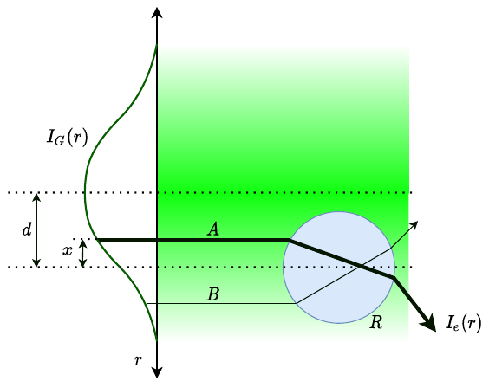

Gaussian source on dielectric spheres
Using a Gaussian source, the intensities vary across the sphere
Ignoring the beam waist and assuming parallel rays,
the incident beam intensity can be written
A scattering and gradient force can be observed
Notes:
In Ashkin’s early experiments, he takes a Gaussian source and points it on a dielectric sphere
In the diagram, there’s a Gaussian source with two rays noted, A and B. Their incident intensities depicted with the line thickness.
As ray A travels across the bead, it is refracted downward. For ray B, it is refracted upward
The net force is to the right and upward toward the beam center.
The net force can be split to two components: a scattering force and a gradient force. The scattering force is due to the initial reflection and the net rightward refraction. It pushes the sphere in the direction of the beam’s propagation.
The gradient force is component which pushes the sphere toward the center of the beam axis.

Slide 7
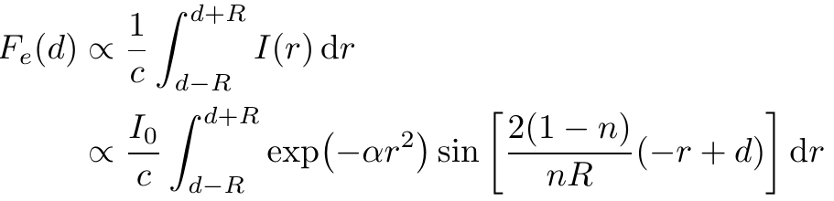
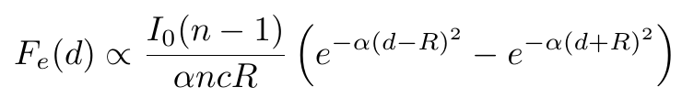
Force approximation using ray optics
Integrating over a disc at a distance d from the Gaussian axis,
Gaussian profile
Due to lens refraction
Notes:
We can estimate the gradient force by integrating the beam intensity across the sphere. This leads to a force that’s similar to a hyperbolic sine

Slide 8
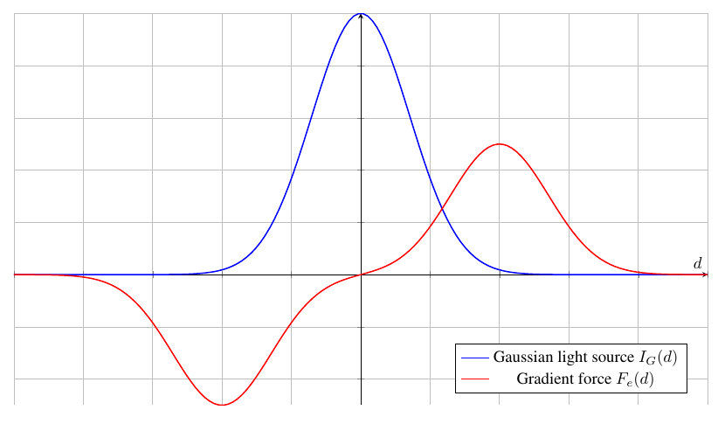
Force approximation using ray optics
Below the beam, it receives a net upward force
Above the beam, it is forced downward
Notes:
Plotting this, we can see

Slide 9
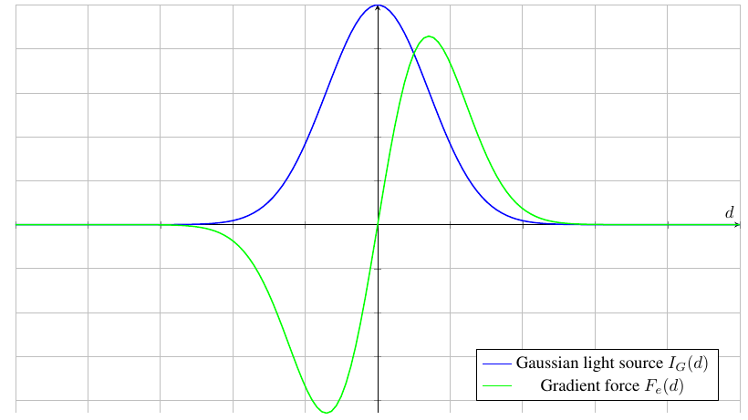

Electric dipole approximation
For a more accurate calculation, the sphere can be treated as an electric dipole
Radiation forces on a dielectric sphere in the Rayleigh scattering regime, Y. Harada, T. Asakura. June 1995.
Notes:
The ray optics approximation I showed is probably easiest to understand, but it’s actually not that accurate. There were several assumptions being made which aren’t necessarily valid.
There’s another approximation that treats the dielectric sphere as an electric dipole and calculates the Lorentz force from the incident light’s E and B fields. The resultant force is proportional to the gradient of the intensity. For a Gaussian source, plotting this gives a similar result but with a narrower effective area.

Slide 10
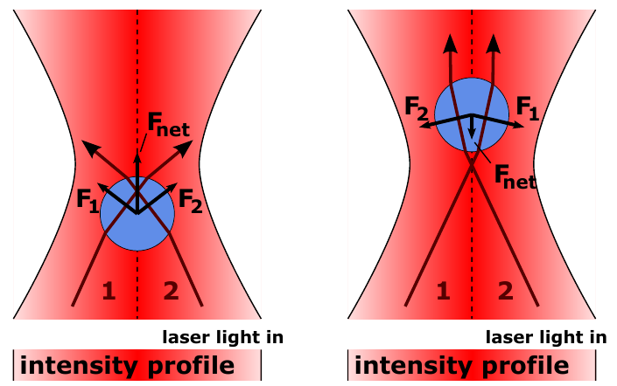
Focused Gaussian beam
Beam can be focused using a high NA microscope objective
Similar principles, but an additional gradient force balances the scattering force
Source: Roland Koebler, 2011. Licensed under CC BY 3.0.
Notes:
Using a single high numerical apature microscope objective and a Gaussian source, a particle can be trapped at the focus of the incident Gaussian beam.
This uses the same principles as an unfocused beam, but now it has an additional gradient: as the particle strays beyond the focus of the lens, there is a separate gradient force that pushes the particle back toward the focus. This can be used to compensate for the scattering force and the particle can be trapped until it is stationary.

Slide 11
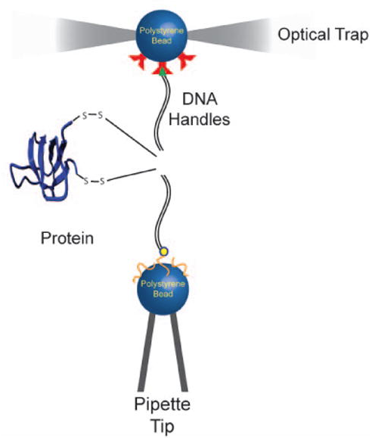
Applications
Common applications in molecular biology and medicine
Capable of trapping single cells and bacteria
Can trap single molecules
Typically, these molecules are “glued” to a glass or plastic bead
Can measure minuscule forces
B Jagannathan, S Marqusee. Protein Folding and Unfolding Under Force, 2013.
Notes:
Optical tweezers have a range of applications. In molecular biology and medicine, they are often used to trap single cells and bacteria, for additional manipulation or to observe biology phenomena.
They’ve been used to isolate and manipulate complex biomolecules, like proteins and DNA. This is often done by gluing these to a bead and manipulating the bead instead. There’s an example of this on the image to the right, where a protein is being folded while held in place using an optical trap. Here, one end of the protein is attached to a plastic bead held in an optical trap.

Slide 12
Summary
Optical tweezers are a method of trapping small dielectric beads
Typically uses a Gaussian source with a high NA objective
Many applications, especially in field of biology and medicine
Notes:
Optical tweezers are a method of trapping dielectric particles
They use the momentum of light to impart forces on particles within an incident beam
Optical tweezers are especially prevalent the field of biology and medicine, where single biomolecules can be held in place and manipulated

